Slide 1
Optimisation
and the management of radiation risks
Carl-Magnus Larsson
CEO, Australian Radiation Protection and Nuclear Safety Agency (ARPANSA)

Slide 2
Optimisation and radiation risk
Effective dose
  a risk-related RP quantity
Managing risk
  role of optimisation
Conclusions
Optimisation and radiation risk

Slide 3
Optimisation in RPS C-1 rev. 1 (2020)*
Optimisation of protection and safety
The process of determining what level of protection and safety would result in the
  magnitude of individual doses,
  the number of individuals (workers and members of the public) subject to exposure and
  the likelihood of exposure
being ‘as low as reasonably achievable, economic and societal factors being taken into account’ (ALARA)
*Code for Radiation Protection in Planned Exposure Situations (arpansa.gov.au)

Slide 4
Protection and safety
and risk
Individual dose
Number of individuals
Likelihood of exposure
Protection
RISK
Safety
Risk describes the chance of harm, which can be expressed as
the likelihood of an event x the likelihood of harm as a result of that event

Slide 5
Optimisation and radiation risk
Effective dose
  a risk-related RP quantity
Managing risk
  role of optimisation
Conclusions
Effective dose
a risk-related RP quantity

Slide 6
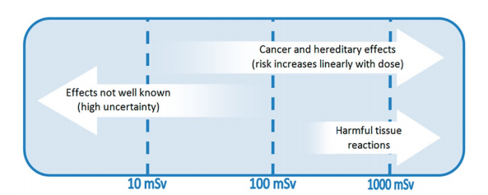
The linear-non-threshold (LNT) model
Ionising radiation and health | ARPANSA
For heritable disease, see Radiation literature survey | ARPANSA

Slide 7
RHSAC* statement on the LNT model
The Radiation Health and Safety Advisory Council supports the continued appropriate use of the ‘linear no-threshold’ (LNT) model as a regulatory tool […]
[…] in situations where radiation doses and dose rates are low, but cautions that the risks from radiation exposure at these levels are commensurately low, and any protective action must be balanced against the benefits of the radiation.
*Radiation Health and Safety Advisory Council, established under the ARPANS Act
May 2017; Radiation Health and Safety Advisory Council statements | ARPANSA

Slide 8
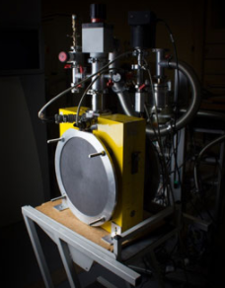
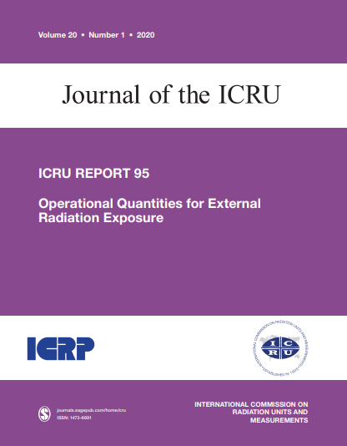
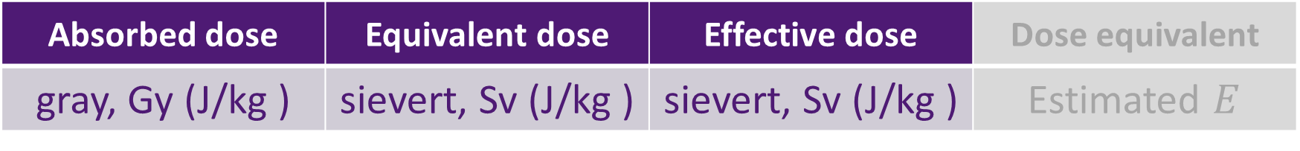


Quantities and units
Absorbed dose | Equivalent dose | Effective dose | Dose equivalent
gray, Gy (J/kg ) | sievert, Sv (J/kg ) | sievert, Sv (J/kg ) | Estimated $E$
$$HT$$
$$E$$

Slide 9
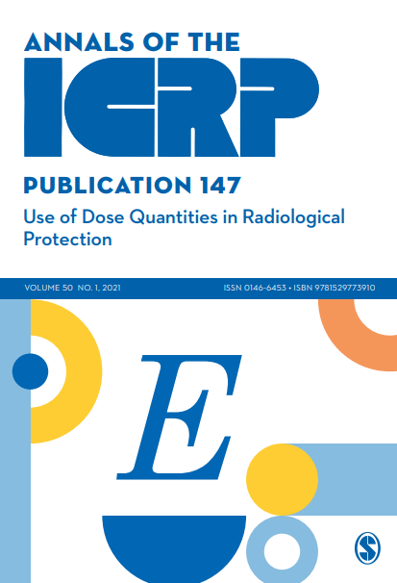
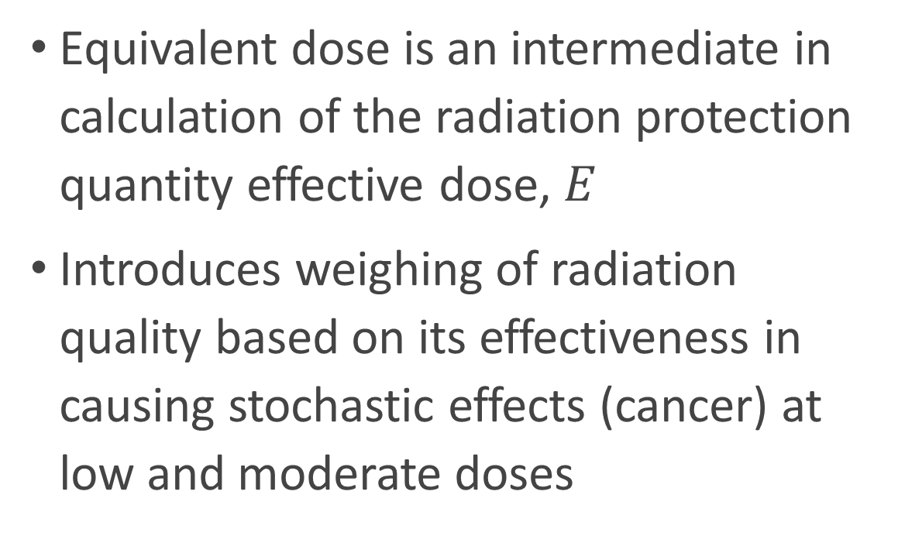
ICRP Publication 147 (2021)
Equivalent dose is an intermediate in calculation of the radiation protection quantity effective dose, $E$
Introduces weighing of radiation quality based on its effectiveness in causing stochastic effects (cancer) at low and moderate doses

Slide 10
ICRP Publication 147 (2021)
Used to set dose limits to prevent tissue reactions at high doses (skin, extremities, lens of the eye)
The use of the same unit (sievert) for two quantities is confusing
Limits to prevent tissue reactions should appropriately be set in gray

Slide 11
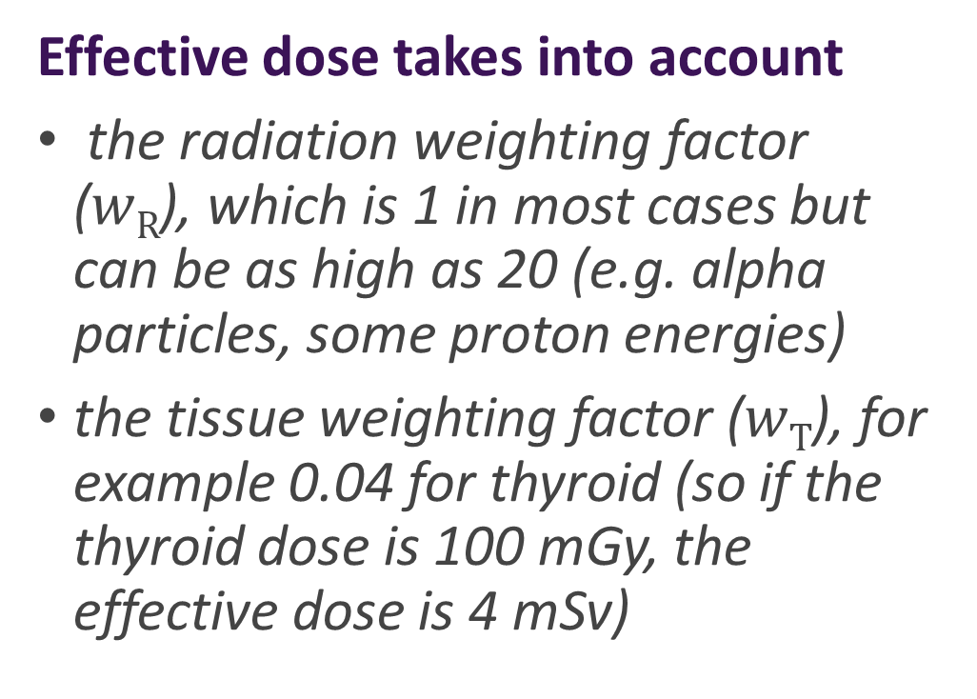


Effective dose, $E$
Effective dose takes into account
the radiation weighting factor ($wR$), which is 1 in most cases but can be as high as 20 (e.g. alpha particles, some proton energies)
the tissue weighting factor ($wT$), for example 0.04 for thyroid (so if the thyroid dose is 100 mGy, the effective dose is 4 mSv)
$$E$$

Slide 12
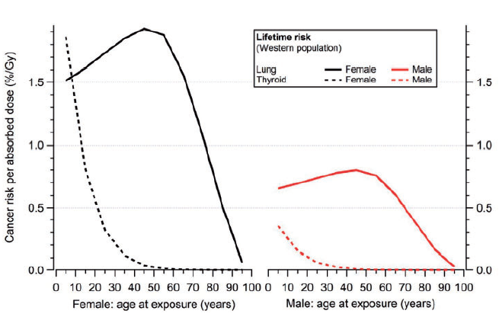
Effective dose, $E$
Takes into account cancer and heritable disease at low dose and dose rate (stochastic effects)
Can be used up to 1 Sv, but attention to tissue reactions
A overall fatality risk of 5% per Sv for RP purposes is reasonable, but note age- and sex-related differences and uncertainties

Slide 13
ICRP Publication 147 (2021)
“Bearing in mind the uncertainties associated with risk projection to low doses or low dose rates, effective dose may be considered as an approximate indicator of possible risk, recognising that lifetime cancer risks vary with age at exposure, sex, and population group […] use of effective dose in this way is not a substitute for specific risk analysis for individual cancer types using organ/tissue doses.”

Slide 14
Optimisation and radiation risk
Effective dose
  a risk-related RP quantity
Managing risk
  role of optimisation
Conclusions
Managing risk
role of optimisation

Slide 15
Justification, Optimisation, Limitation
Action
Justified?
Yes
Planned exposure situation
Optimise against constraint
No
Yes
Existing/emergency exposure situation
Optimise against reference level
No action
Decision
Exposure situation
Management of dose and risk

Slide 16
Optimisation by design (ICRP P103)
(214) Optimisation is always aimed at achieving the best level of protection under the prevailing circumstances through an ongoing, iterative process that involves:
  evaluation of the exposure situation, including any potential exposures (the framing of the process)
  selection of an appropriate value for the constraint or reference level
  identification of the possible protection options
  selection of the best option under the prevailing circumstances
  implementation of the selected option.

Slide 17
Potential exposure and safety assessments
The evaluation of potential exposures involves
  construction of scenarios leading to exposures
  assessment of their probabilities
  assessment of the resulting dose and associated detriment
  comparison with some criteria of acceptability
The probability of occurrence and the magnitude of the resulting dose and risk can be considered separately, but can also be combined to estimate the probability of health effects attributable to the radiation exposure resulting from an unlikely event

Slide 18
Constraints
Planned exposure situation
RPS C-1 Rev 1 (2020)
A prospective and source related value of individual dose (dose constraint) or of individual risk (risk constraint) that is used in planned exposure situations as a parameter for the optimisation of protection and safety for the source, and that serves as a boundary in defining the range of options in optimisation.
Code for Radiation Protection in Planned Exposure Situations (arpansa.gov.au)
Dose limit
Dose and/or risk constraint
Dose/risk
Optimisation of protection and safety

Slide 19
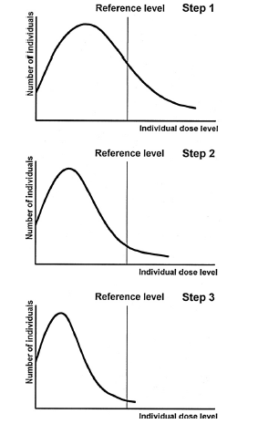
Reference levels
Emergency/existing exposure situation
The reference level is defined as dose
Reference level
Dose

Slide 20
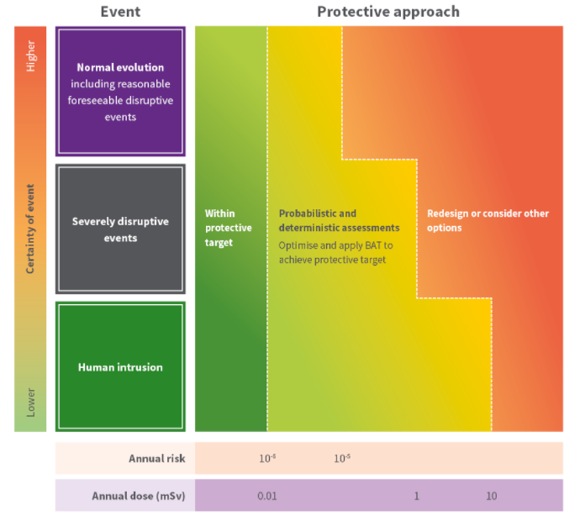
Optimise using dose and risk (and beyond)
Source:
Dose and risk criteria for protection of people following the closure of a disposal facility for radioactive waste | ARPANSA

Slide 21
Optimisation and radiation risk
Effective dose
  a risk-related RP quantity
Managing risk
  role of optimisation
Conclusions
Conclusions

Slide 22
Ground rules
Optimisation is a multifactorial concept
Always includes a risk component
‘Doses are ALARA’ is not enough
Let constraints (reference levels) be guided by (inter alia) the risk assessment, not by what is ‘doable’
Avoid ‘evaluating away’ the likelihood of an event
Identify critical controls and monitor their efficacy
Apply a graded approach

Slide 23
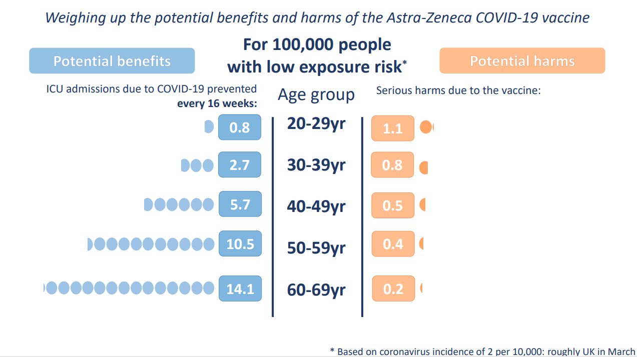
How big is a small risk?
Winston Centre for Risk and Evidence Communication
University of Cambridge

Slide 24
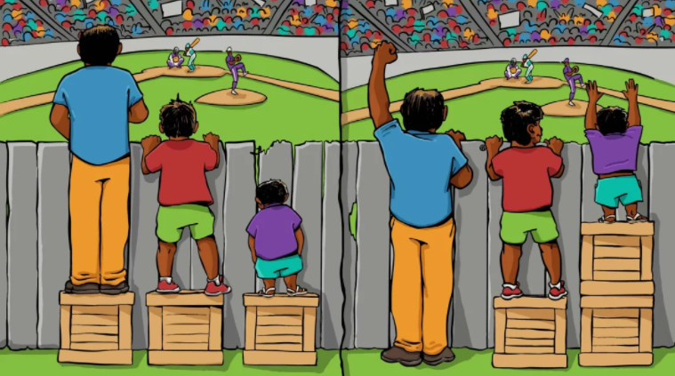
Equity and optimisation
Equality – all receives the same
Equity – all receive what they need
Limitation together with Optimisation promotes equity
Equality
Equity

Slide 25
info@arpansa.gov.au
Website: arpansa.gov.au

