Slide 1
ARPANSA RSB Update
2022 ARPANSA Licence Holder Forum

Slide 2
AUKUS

Slide 3
Amendments to the ARPANS Regulations
Target date – 1 July 2022

Slide 4
General reasons for amendments
To reflect international best practice
To address/strengthen and clarify issues raised during oversight activities
To bolster ongoing regulatory initiatives
Detailed information on changes will be provided closer to implementation

Slide 5
Licence Applications
From July 2022 licence applications will be indexed by 2%
The increase is to recover the actual service costs

Slide 6
Exempt Dealings
Concepts, dose criteria and terminology for exempt dealings updated to align with IAEA GSR Part 3
Disposal requirements for solid material updated to align with GSR Part 3 – clearance levels from GSR Part 3 can now be used
Exempt dealings – NIR. A number of clarifications made particularly around radar detection and ranging systems and optical sources

Slide 7
Incidents/Accident Terminology
“Incident” is now term used rather than “accident”
Change to terminology aligns with RPS C-1 and IBP with IAEA GSR Part 3
Regulation s58 now uses the term “notifiable incident” rather than “accident” in regard to 24 hour reporting requirement

Slide 8
Human and Organisational Factors
ARPANSA has promoted holistic safety since 2012
Changes to regulations reinforce holistic safety and consistency with GSR Part 2
Changes place clear obligation to prevent human error and strengthen organisational factors
HOF to be integrated into:
  Safety analysis reports, plans and arrangements
  Learning opportunities following notifiable incidents

Slide 9
What we did
What we found
Learnings
Inspection Outcomes
Apr 2021 – May 2022

Slide 10
Inspection Program Overview
Set Regulatory Priority
Schedule Inspection
Plan and Request Docs
Inspection
Inspection Outcomes
Regulatory Priority informed by:
For Sources - inherent hazard of the source
For Facilities – Using a risk ranking methodology
Inspection scope defined by:
Performance Objectives and Criteria
Applicable Codes and Standards
Licence holder commitments
Past performance
Area For Improvement
Good Practice
Non-Compliance
Feedback
(survey)
Notes:
Quick overview. Risk informed inspection schedule, looks at past performance.
GP: above expectations, others could benefit
AFI: could align with IBP or otherwise enhance safety performance
NC: Non-compliance with the Act/Reg/Licence conditions, may be considered serious.

Slide 11
Inspections Performed
24 Inspections
  13 Source
  11 Facility
Outcomes
  20 Compliant
  4 Potential Non-Compliant
Notes:
In 2016 there was a decision to reduce the number of inspection of low-hazard source licences
The 2018 and 2019 numbers is a more typical representation and reflects the risk based approach
2020 and 2021 reduction is primarily attributed to the COVID-19 pandemic and associated travel restrictions
24 Inspections
13 Source
11 Facility
Outcomes
20 Compliant
4 Potential Non-Compliant

Slide 12
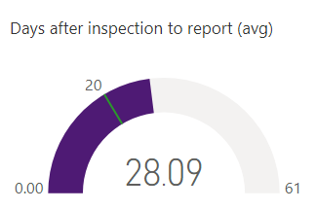
Regulatory Insights
Licence Applications
  4 Change Applications
  2 New Licence Applications
Reviews
  50 Licences Re-Issued
  30 requests under Section 63 of the Regulations
Reporting Timeframe
  Average 28 days down from long term average of 40 days
Notes:
Stats on this page taken from LAD Reports
AFIs
Data as of 5/18/22, 6:11 PM
Filtered by DateInspectionStarted (4/20/2021 - 5/19/2022)

Slide 13
Good Practice
The use of external video cameras capable of providing safe observation from outside the laboratory when forensic examination of radiological materials takes place thereby limiting the risk of exposure [ANSTO Source 05-2021]
An electronic radiation source inspection checklist developed by CSIRO is used to assess the compliance of a controlled apparatus with both CSIRO’s internal requirements and their licence condition requirement with respect to relevant codes and standards. [CSIRO, 06-2021]
The use of computer aided modelling of the floor plan or layout of the indoor area in which industrial radiography is to be conducted for the purpose of identifying areas of potential exposure and establishing safety boundaries. [ASD, 04-2021]

Slide 14
Breach (Significant)
S60(1) - Radioactive material exceeded safety case
Failure to comply with subsection 60(1) of the Regulations in that it has not effectively managed nor stayed within the safety case as it relates to a specific isotope
Notes:
ANSTO (Health) - Radioactive material exceeded safety case
Failure to comply with subsection 60(1) of the Regulations in that it has not effectively managed nor stayed within the safety case as it relates to Lu-177. Compliance with section 60 of the Regulations is a licence condition of F0262. Subsection 30(2) of the Act requires the licence holder to comply with the licence conditions.

Slide 15
Breach (Significant)
S63 – Significant change without prior approval
The licence holder did not obtain prior approval of the CEO of ARPANSA to make a change that had significant implications for safety - namely altering the interlocks on the Linear Accelerator
S61- Ineffective review plans and arrangements
The licence holder has failed to effectively review plans and arrangements within three years as required by section 61 of the Regulations. The Source Security Plan had not been revised since its original issue in 2013.
Notes:
ANSTO (source) - Security plan out of date
The licence holder has failed to effectively review plans and arrangements within three years as required by section 61 of the Regulations. The Source Security Plan for Source Licence S0045 (Rev 0) October 2013 had not been revised since its original issue.
ARPANSA - Did not submit section 63
The licence holder did not obtain prior approval of the CEO of ARPANSA to make a change that had significant implications for safety - namely altering the interlocks on the Elekta Synergy Linear Accelerator

Slide 16
Breach (Other)
Failure to Comply with Code or Standard (x3)
Fail to comply with Licence Conditions (x3)
Failure to report (x2)
Plans and arrangements not followed or not reviewed (x1)
Unauthorised Dealing (x1)
Disposals and Transfers (x1)

Slide 17
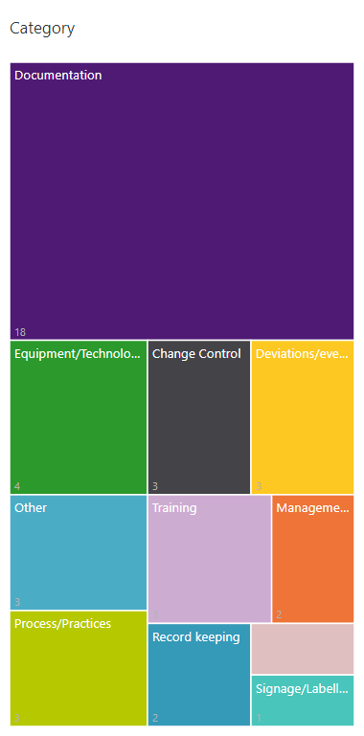
Area For Improvement
Documentation
e.g. not up to date / reviewed
Equipment/Technology
e.g. inspection, servicing and testing
Change Control
e.g. system to capture temporary or permanent changes not captured in plans and arrangements
Deviations/events
e.g. monitoring and reporting of exposure
Training
e.g. not carried out, not detailed or not verified
Process/Practice
e.g. suggested improvements
Other
e.g. Safety and/or security classifications and interface
42%
9%
7%
7%
7%
7%
5%
7%
5%
Notes:
AFIs
Data as of 5/18/22, 6:11 PM
Filtered by Included (4) (2022 (Year), 2021 (Year) + Qtr 3 (Quarter), 2021 (Year) + Qtr 4 (Quarter), 2021 (Year) + Qtr 2 (Quarter))
Note: 21 AFI Sub-Category of Other (44%)
Do we need to define additional POC metrics?

Slide 18
Lessons
Ensure operations remain within approved safety case
Documentation AFIs continue increasing and are most commonly reported
Change Control/ Process & Practice contributing to breaches or AFI
  Training, Management Oversight, Deviation from Procedures will be a focus
Notes:
Jim may also want to mention the value of completing the post inspection survey

Slide 19
RSB HOF Integration Program

Slide 20
Program Aim and Strategies
4. Data driven and learning based approach
2. Encouraging self-monitoring, voluntary compliance and continuous improvement
1. Empowering inspectors
World-class, integrated HOF regulatory systems that fosters LH safety performance
3. Facilitating transparent and collaborative relationships
Notes:
Orange circle is the aim and vision
Outer circles illustrate the four strategies to enable the vision

Slide 21
Activities supporting strategies
Ref | Activity
1 | Amendments to legislation
2 | Amendments to forms
3 | Holistic Safety Guidance Update
4 | Technical HOF Manual for inspectors
5 | Training for inspectors
6 | Site visits for HOF
7 | Stakeholder Engagement and Communications Plan
8 | Interactive e-learning modules for licensees
9 | HOF Data System (RAD)
Notes:
The first 3 blue activities relate to documentation to support both regulator officers and licence holders
Pink activities aim to empower inspectors in the HOF domain
Green activities aim to enhance open, understanding and collaborative relationships with licence holders
Yellow activity is extra services to encourage voluntary compliance and continuous improvement
Purple activity is our data system to supply an evidence and learning based approach to regulation

Slide 22

For more information
Joy.ho@arpansa.gov.au
John.ward@arpansa.gov.au
Visit ARPANSA HOF Coffee Corner
Notes:
For more information please email Joy or John
OR
Visit the Coffee Corner

