Slide 1

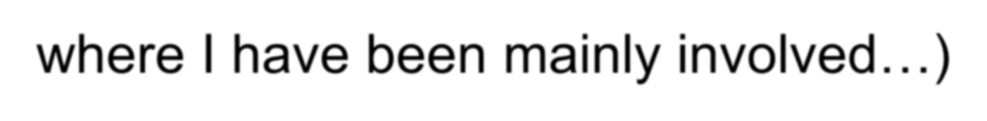
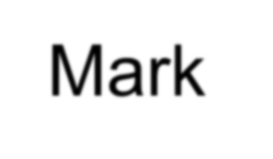
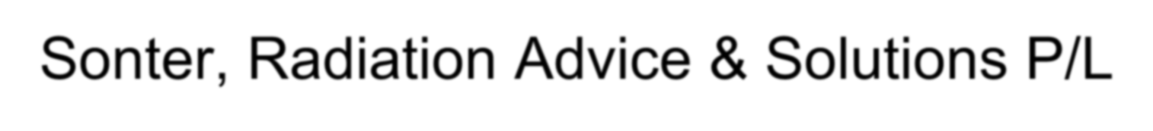

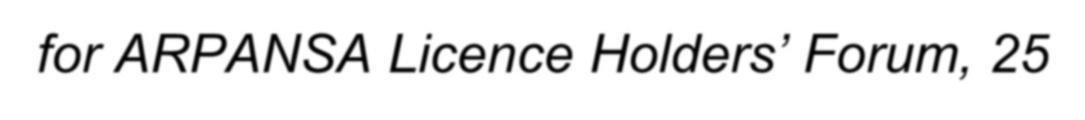
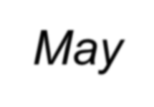
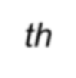
Radwaste stories, and some general lessons
(With a focus on the mining and oil & gas areas, because that’s where I have been mainly involved…)
Mark Sonter, Radiation Advice & Solutions P/L
- for ARPANSA Licence Holders’ Forum, 25th May

Slide 2


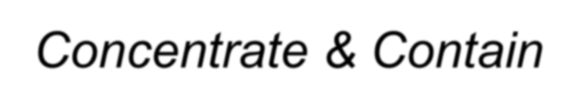
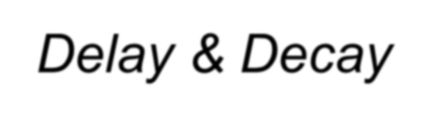
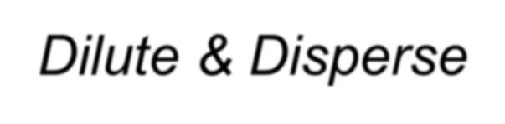





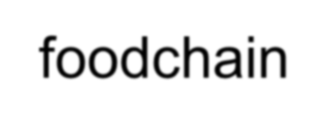

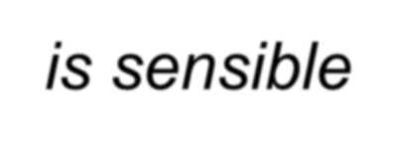
Return to First Principles:
Concentrate & Contain
Delay & Decay
Dilute & Disperse
‘Dilute & disperse’ absolutely should remain ‘in the mix’ – if foodchain or
chemical reconcentration is not realistic, then dilution is sensible
What, if any, are the ‘dose consequences’ of proposed control?
if none or minor, we should manage accordingly
(and push back against demands for OTT responses)
Note: ‘Collective dose’ is an abomination, should have been strangled at birth…

Slide 3



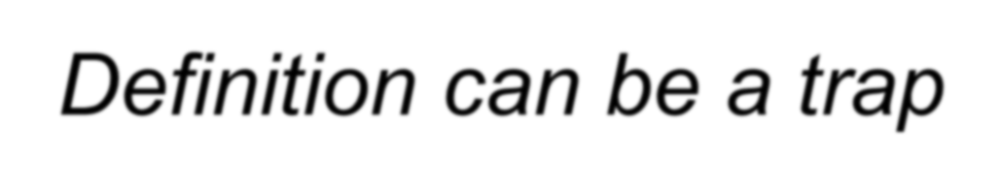


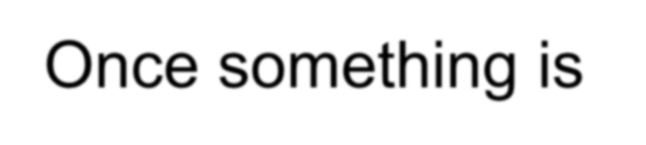

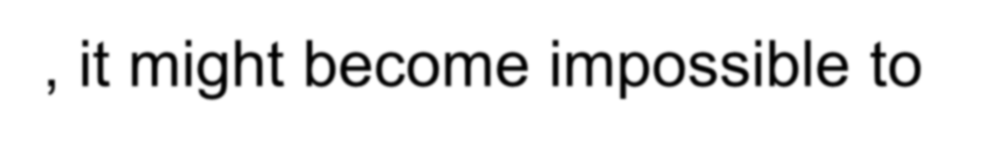
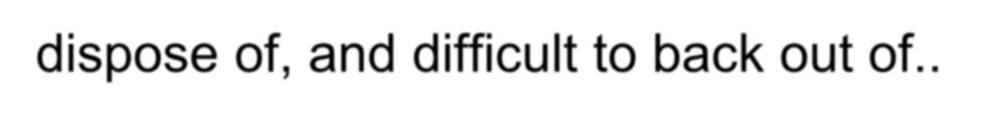
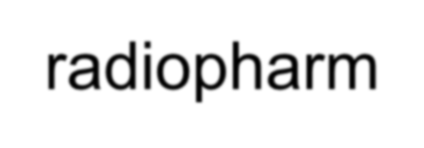
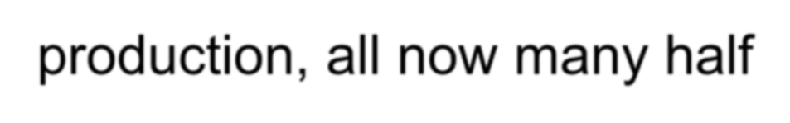

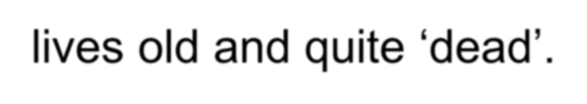
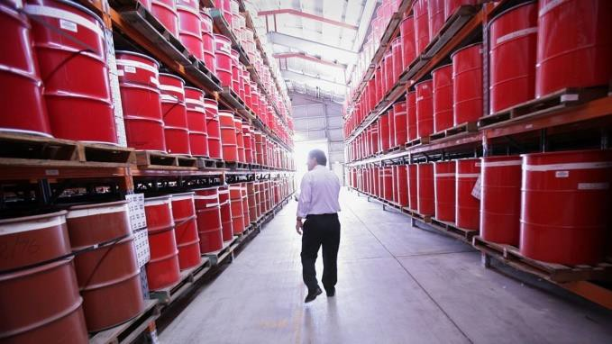

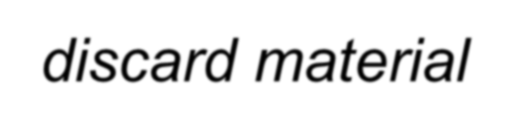
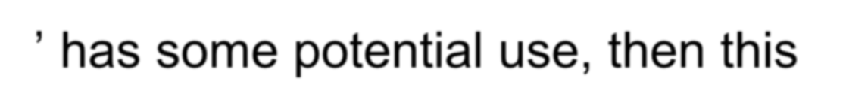

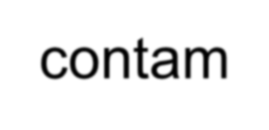
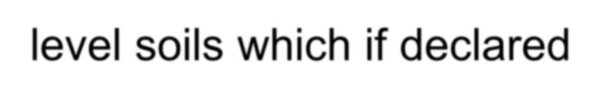
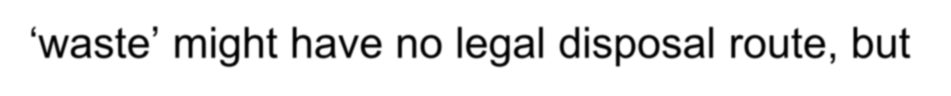
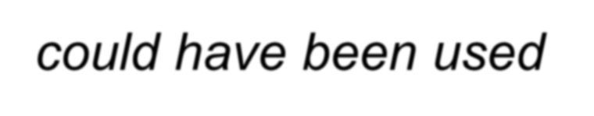
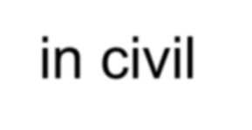
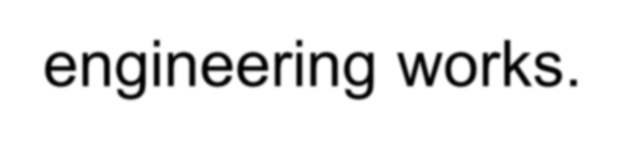
What is Radioactive Waste? Definition can be a trap…
Once something is defined as waste, it might become impossible to dispose of, and difficult to back out of..
Example: the thousands of drums of rubbish from ANSTO’s radiopharm
production, all now many half-lives old and quite ‘dead’.
If ‘discard material’ has some potential use, then this may solve your disposal issue even if it costs something..
Example: very low contam level soils which if declared
‘waste’ might have no legal disposal route, but could have been used in civil engineering works.

Slide 4


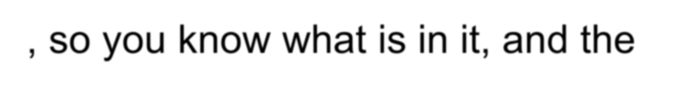

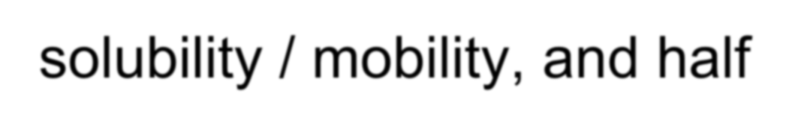

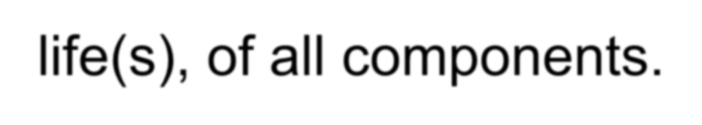
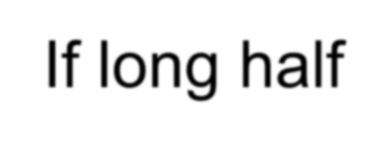

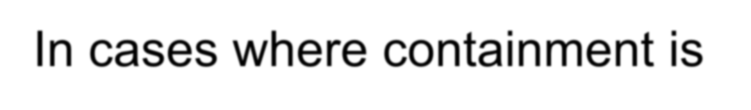
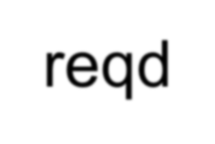
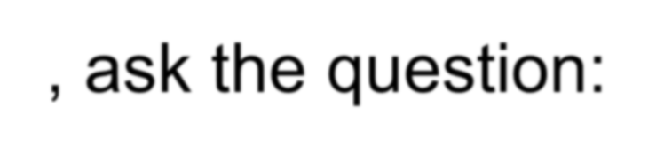
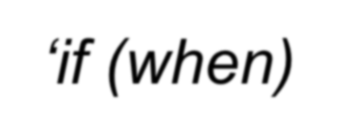
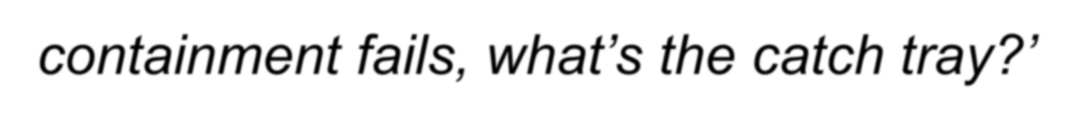
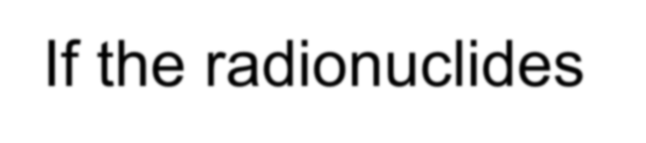
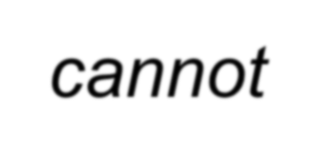
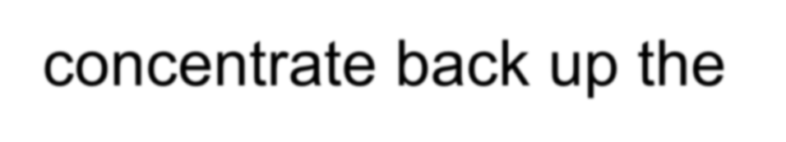
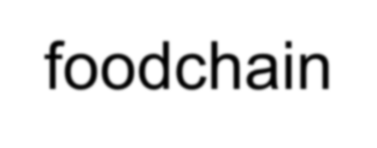
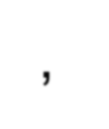
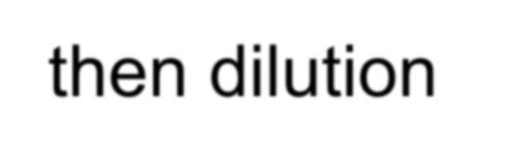
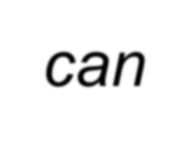
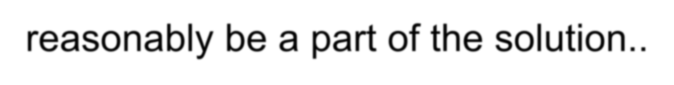
The Basics:
Characterize your waste, so you know what is in it, and the solubility / mobility, and half-life(s), of all components.
If long half-life, then we need a disposal (not storage) solution, and would like the material to be definitively insoluble. Otherwise need robust containment.
In cases where containment is reqd, ask the question: ‘if (when) containment fails, what’s the catch tray?’
If the radionuclides cannot concentrate back up the foodchain, then dilution can reasonably be a part of the solution..

Slide 5
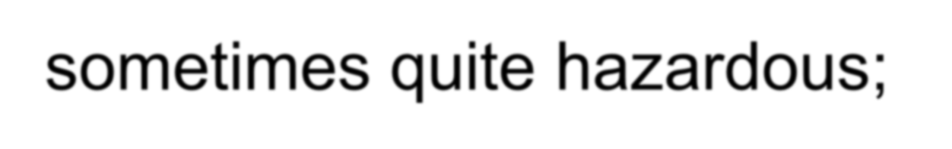
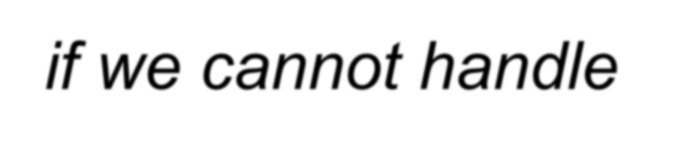
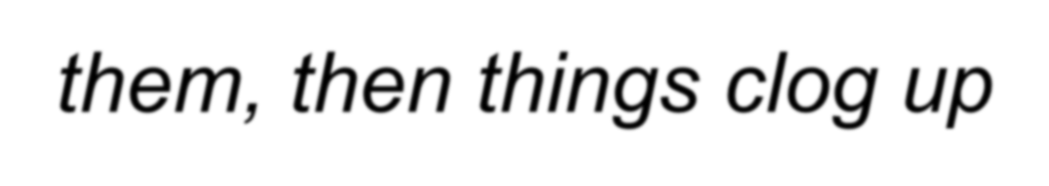

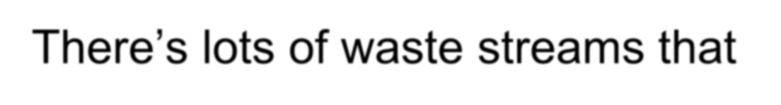



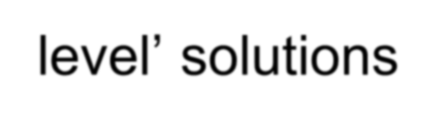
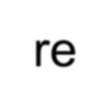

An advanced technical society produces wastes, sometimes quite hazardous; if we cannot handle them, then things clog up…
There’s lots of waste streams that should not need ‘heroic-level’ solutions
But which may be adequately addressed by secure storage, or by controlled re-use, or by controlled dilution and dispersion
We need to seek, and support, simple robust solutions
Public perceptions and politics make this difficult.
But we have to keep at it. Don’t give up. Be a voice for reason.

Slide 6












Legacies from early days:
Hunters Hill Radium Refinery 1912-1916
Total output: approx 1 g Ra (!!)
From about 1000 t of ore from Radium Hill..

Slide 7










Hunters Hill as of ‘now’
Ra contaminated soil, long saga, now going to Idaho – several lost opportunities due to failure of nerve, and to political ‘windows’ being missed

Slide 8





















RH should have been confirmed as a formal disposal facility and it could then have supported a wider use. But the opportunity was lost with the premature death of Peter Hill the Director of Mines…
The on-site slimes dam was used during the 1990-2000 era via several one-off approvals by SADME and SAHC for disposal of various
cleanup loads from Honeymoon and from the little old pre-WW2 radium refinery at Dry Creek.

Slide 9












































Radium Hill Gravity Concentrate was railed to Port Pirie U plant, behind the lead smelter, located there to take acid from their sulphuric acid plant.
Unneutralized tailings were disposed into an unsealed dam adjacent to the tidal flats (Argghh!!!)

Slide 10
















Rum Jungle: started 1952
Produced 3700 t U₃O₈ in the period up to 1970
Underground exploration shaft and drives, but production
was from several open pits.
Copper (sulphides) also
present..

Slide 11





White’s Open Cut, completed to depth of 107 metres in 1958

Slide 12






















Rum Jungle - Two Impacts
Release of Acid Tailings Liquor (by an engineer who didn’t understand pH:
‘Oh, you mean mixing equal vols of pH 1 and pH 7 doesn’t give you pH 4 ?’
Then, Acid Mine Drainage post-closure due to bacterial leaching of sulphide containing Waste Rock Dumps produced H₂SO₄ and released Cu, killing aquatic life and East Finniss riverside wetlands vegetation
Ultimately cleaned up at cost of $18M; but with further followups since..
Tailings disposal in the wet tropics is a nightmare (see later discussion re Ranger Uranium)

Slide 13














Rum Jungle was a serious environmental embarrassment to the AAEC (and to CRA), which raised the question, if the govt, and a big mining company, on a cost-plus contract, cannot do it safely, can anyone?
Was trigger for the Fox Report

Slide 14











South Alligator mines: Rockhole and Moline
At both sites, tails disposal was ‘a pipe out the side of the mill building’…
Moline mill, South Alligator, both photos 1979
South Alligator, Rockhole Mill:
Sign says “No Camping – Radioactive Uranium Mill Tailings” (heheh!)
So, yeah, there IS a reason for regulatory review of environmental impacts & disposal plans…

Slide 15








Brochure advertising the re-opening of Mary K, 1976
Was a lovely little township…

Slide 16






MKU pit, end of 1st operation, 1963… It had been one of the biggest U-mines in the world…
Memories of Mary Kathleen Uranium

Slide 17







Ammonium Diuranate (ADU) is very pretty canary yellow… ADU Precip tank in foreground

Slide 18










MKU tails dam was the first to be properly rehabbed: capped, rock-armoured, cutoff drains etc..
At end of operations, the plant was demolished and unsalvageable structure disposed of into the open pit, which has been allowed to fill.
But – Mary K ore was in fact a rare earths ore (bastnaesite) - ca 4% REE, with minor uranium (0.08%!)..
So the tailings is actually an REE orebody…
Another case where ‘waste’ might actually be ‘resource’…

Slide 19












Nabarlek - November 1979 (mined out in 6 months)
.. was backfilled with tailings over the next 12 years..
And successfully rehabilitated (with some minor fixups reqd)

Slide 20










Ranger:
Commenced mining 1979; Pit #1 getting covered, tails going into Pit #3.
Massive, massive waste water control problems. (Regulator induced, unnecessary)

Slide 21


Beautiful setting, Mt Brockmann to the south
Pit #3 (there was no pit #2) about 10 yrs ago.
Now backfilled with tails from tailings dam.

Slide 22







Ranger Calciner change-out, and a security issue: unknown amount of contained yellowcake.

Slide 23









.. So we placed it in pit #3 to be buried under the tailings…
A successful and cost effective outcome..
Disposal with a view to longest possible term security
Discussed with ASNO..

Slide 24



Olympic Dam Pilot Plant, 1984
..a most full-on and exciting period in my career professionally and scientifically..
Olympic Dam underground development started 1982; stoping from 1988

Slide 25












Olympic Dam: production started 1989, now mines about 10 million tons of ore / year to make 4,500 tonnes U₃O₈ (and 200,000 tonnes Cu)
(thus produces 10 mtpa of (very) low level radwaste)

Slide 26


















Big, complex operation:
Oly Dam, ca 1989
‘five dissimilar aircraft types trying to fly in formation’
(quote from Bob Crew, first Resident Manager)
Mine
Concentrator (crushing grinding & flotation)
Hydromet (leaching & solvent extraction)
+ Yellowcake precip & calcining
Copper Smelter
Electrolytic Refinery & PMs plant
Ancillaries (acid plant & oxygen plant)

Slide 27



Open Stopes produce massive voids the size of large skyscraper office blocks – which have to be backfilled with a weak concrete / waste rock / tailings sand mix so as to stabilize the surrounding ground and enable ongoing mining extraction

Slide 28


Slide 29









Disposal into large mine stopes during backfill operations is quite sensible..
Huge volumes of material that has been (presumably) totally stripped of economic value, no intention of ever re-entering, or re-mining, stabilized with cement for strength..
Perfect for disposal of old sealed sources..
Was done formally in Qld at Mount Isa Mines for disposal of their obsolete sealed sources, during the 1970’s and 80’s.

Slide 30

















Olympic Dam “coulda’ been” Australia’s underground waste disposal facility
Plan (1991) was for dedicated underground drives to be leased or operated under specific licence to take LLRW & ILRW..
Proposal formally went to govt (both state and feds - to Simon Crean)
Obstruction from a key second-tier state public servant, who stalled supporting
letter, then ‘events intervened’…

Slide 31













Beverley Uranium Mine near Arkaroola Sth Australia
-- In-Situ Leach, started in 2000
Downhole disposal into confined mined-out uranium- bearing aquifer, simple…

Slide 32












Maralinga, 1998-99 cleanup
Handed back by UK after a very poor cleanup in ca 1968
Outback trekkers start finding coin-sized bits of ‘Heavy Metal’..
Scraping and reburial of extensive areas of Pu-contaminated soil
Exhuming & reburial of contents of 21 large disposal pits
(after abortive and stupid attempt to immobilize via in-situ vitrification)

Slide 33











‘Taranaki’ site:
Soil contamination was not from the bomb tests, but from the (200 or so) trigger trials and safety trials.
These generated plutonium oxide fume which spread and deposited downwind..

Slide 34











The workplace health issue at Maralinga:
Massive concern re airborne / resuspended ‘hot particles’: possibility of
individual Pu/Am particles carrying ‘many ALIs of activity’
Thus ‘heroic levels’ of vehicle air filtration. All outside-cabin activities in hot zone were in full-face respirators & Tyvek overalls.
Focus on decon / clean/dirty zone boundary control etc
Strange mental misread: the (US based) Health Physics contractor was fixated on beta-gamma whilst the actual issue was alphas from Pu & Am

Slide 35



Huge HEPA filters (for engine intakes as well as cabin aircons); sealed doors, overpressure cabins..
Steel tent over one of the disposal pits,
prepped for In-Situ Vitrification

Slide 36












Mineral sands
“Thanks, Premier, for shutting us down; We won’t all be able to get jobs as baristas and whale-watching guides.”
Enterprise Mine, North Stradbroke Island
Signed, local AWU Shop Steward

Slide 37









Mineral sands
Monazite-bearing ‘zircon mags’ waste is/was trucked back from dry plant and buried in mine overburden sand to depth of 10-20 metres
-- but it’s an REEs resource right now, and a future thorium resource!!

Slide 38

















Oil & Gas NORM management & disposal:
There’s lots; Ra in scale and sludges; & some is a bit hot (MBq/kg levels)
Most of this material is ‘categorically’ insoluble, so technical solutions do exist..
But politically, disposal options very restricted (in some jurisdictions, none):
  Store indefinitely, ie, ‘concentrate and contain’, not practical without
approved radwaste storage site
  Dispose via ‘dilute and disperse’, then pump overboard, can be shown
to be intrinsically safe. But regulators fear political blowback.
  Dispose of down depleted wells. Loose, or cemented into old drillpipe.
  Dilute / blend down and dispose of in landfill, roadbase, or landfarm.

Slide 39



Slide 40










Timor Gap Sub-Sea Heat Exchanger
recovery, demolition, and descale exercise:
Pointless and very expensive. (Ended up w 9 tonnes of Ra scale going to Idaho..)

Slide 41









Sealed sources as waste:
Simple, already encapsulated, short half-lives.. But some can be
quite high or even extremely high activity..
Reuse actually works: Mike Malaxos in WA was taking old sources, checking for integrity, then re-engineering into new source containers for a second life.
Also, ‘delay and decay’ actually works: many of the obsolete items can be stored until half-life works its way..

Slide 42










Mt Walton, & now Tellus at Sandy Ridge
Both marvellous sites, geologically..
Mt Walton has a history of operation now for > 20 yrs, albeit small-scale (I visited in 1995..)
From Tellus webpage:

Slide 43















Conclusions:
Understand your waste – it may be possible to repurpose it!
Understand the chemistry and the environment – or else bad things may occur
Understand the possible dose delivery pathways – and quantify them (RESRAD)
Always remember first principles!! – and seek to ‘Keep It Simple, Stupid’
Seek to achieve robust engineering, avoiding risky ‘sci-fi’ solutions
-- then and only then will you be able (perhaps) to
Push back against excessive control instincts / demands
And achieve safe and cost-effective outcomes

