Slide 1
Licence holder Forum 2019
Chris Nickel - Safety Systems
Inspection Outcomes
Notes:
welcome

Slide 2
Inspection Program Overview
Feedback
(survey)
Set Regulatory Priority
Schedule Inspection
Plan and Request Docs
Inspection
Inspection Outcomes
Regulatory Priority informed by:
Hazard of source of facility
Hazard & level of control of the facility (inc. past performance)
Inspection scope defined by:
Performance Objectives and Criteria
Applicable Codes and Standards
Licence holder commitments
AFI
Area For Improvement
PNC
Potential Non-Compliance
GP
Good Practice
Notes:
Quick overview. Risk informed inspection schedule is affected by past performance (for facilities),

Slide 3
‘Good Practice’ identifies were a licence holder has a practice which is considered superior to that observed elsewhere and goes beyond the fulfilment of requirements or expectations. This helps to highlight and share good practices.
Good Practices

Slide 4
Good Practice
A specifically designed and installed source transfer port between sample preparation and counting laboratories mitigates handling risks when transferring sources between adjacent rooms. [ANSTO]
Implemented a system where access to a source store required the expressed permission and physical presence from two staff who operate under independent management streams. This measure was designed to minimise insider threat concerns and is a simple and effective arrangement. This is greater than those specifically requirement under RPS11. [Defence]

Slide 5
Good Practice
Two site radiation safety officers (RSOs) at a site, with designated responsibility within the radiation protection plan for sources in the Secure Area and the Non-Secure Area. The initiative to maintain a permanent on-site presence of two RSOs with clear responsibility for radiation safety in a highly compartmentalised and restricted operating environment to be good practice for maintaining uniform and effective radiation safety across the site.
[CSIRO, Australian Animal Health Laboratory (AAHL)]
Radon remote sensing monitors were installed allowing real-time radiation protection information to be available prior to entry into waste stores. [ARPANSA, Yallambie]

Slide 6
Non-Compliance
Confirmed breach of the Act, Regulations, or licence conditions
*

Slide 7
Types of non-compliance - long term (2017-2019)
Notes:
Complying with Codes and standards or Plans and arrangements are most common for Facilities
For Source: Inventory & reviewing plans and amendments

Slide 8
Factors considered in regulatory response
Safety consequences
Actual and potential consequence
Impact on the community and/or the environment
Could affect the public?
Impact on the regulatory process
Mitigating circumstances
Cooperation and disclosure
Nature of discovery
Self-reported / Inspection / Other
Level of intent
Known to operator, foreseeable
Compliance history
Similar incidents / AFIs
Notes:
As published in our guide online.
Consequences (to workers or the public)
Impacts our oversight
Self-reported
Should have known better

Slide 9
Types of non-compliance FY2018-2019

Slide 10
Types of non-compliance FY2018-2019
Notes:
A significant fraction relate to not doing things in the way that was agreed

Slide 11
Types of non-compliance FY2018-2019
Notes:
Most of the Non-compliances relate to Change management, keeping risk assessments, P&A up to date and maintaining the inventory. (as discussed this is important)

Slide 12
Breaches with safety significant implications
Not seeking approval for a significant change
Result of failing to seek approval for a change which had an inherent risk of radiation exposure in excess of the statutory dose limit.
Not seeking approval for a significant change
Failing to seek approval to conduct helicopter training exercises adjacent to, and within, the a legacy site.
Notes:
Change Management, risk identified but not notified, risk not identified.

Slide 13
Breaches with safety significant implications
Not meeting an applicable Code
Failing to meet transport requirements on two occasions as required by the organisation’s own procedures and the Transport Code [Radiation Protection Series C-2 (Rev. 1) Code for the Safe Transport of Radioactive Material (2019)]
Failed to comply with plans and arrangements
Process involving transport of a molybdenum-99 quality control sample within the facility resulting in a spill and minor personal contamination.
Notes:
Compliance
Transport – public dose
Actual or potential impacts

Slide 14
Examples of accidents that must be reported within 24 hours under
section 58 of the Regulations include:
Any occurrence that is rated at, or has the potential to be rated at Level 2 or above on the International Nuclear & Radiological Event Scale (INES)
An occurrence that causes or may lead to radiation doses exceeding the statutory annual dose limits to workers or members of the public.
Lost or stolen controlled apparatus or controlled material Group 2 or above.
...See regulatory guide for full list…
Reported Accidents
Notes:
Section 58 Reportable accidents (Significant Events)

Slide 15
Significant events reported to ARPANSA
On Friday 21 June 2019, ARPANSA was notified by ANSTO of a radiation contamination event at the ANM production facility in Lucas Heights. Two workers received a dose that exceeded the statutory annual dose limit for the hands. This event was determined to be an accident under section 58 of the regulations.
  ARPANSA inspectors conducted a site visit on the same day, and further site visits and an inspection in the following weeks.
  On Friday 5 July, the CEO of ARPANSA permitted restricted production in the ANM Facility to a level that can satisfy the domestic demand for nuclear medicine only.
  ARPANSA is continuing its investigation into the causes and contributing factors of the accident.
Notes:
One reported accident in this period, which is still under investigation – level 2 INES

Slide 16
‘Areas for improvement’ (AFI) identify when a licence holder does not follow accepted best practice or does not meet self-imposed requirements, but the Licence holder is not contravening a legal requirement. These represent an area where the licence holder should improve their safety and security systems and practices.
Areas for Improvement

Slide 17
AFI over time

Slide 18
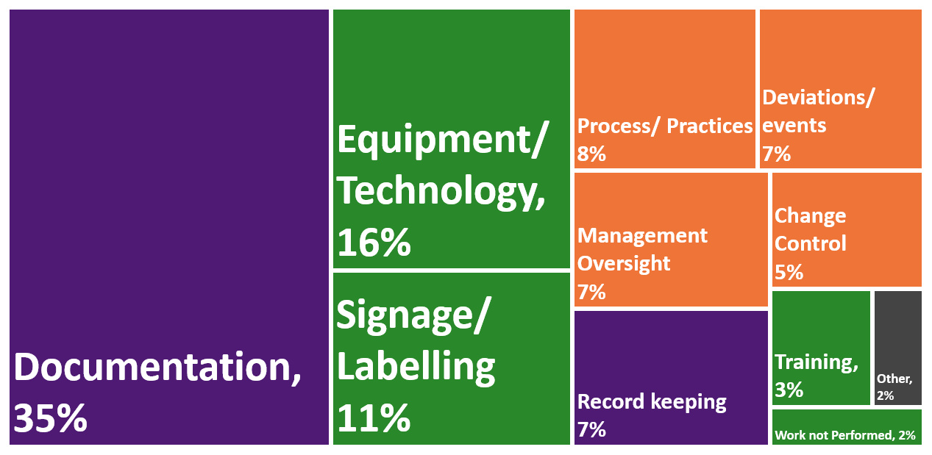
Areas for Improvement - FY2018-19
Notes:
Broad categories for internal analysis purposes

Slide 19
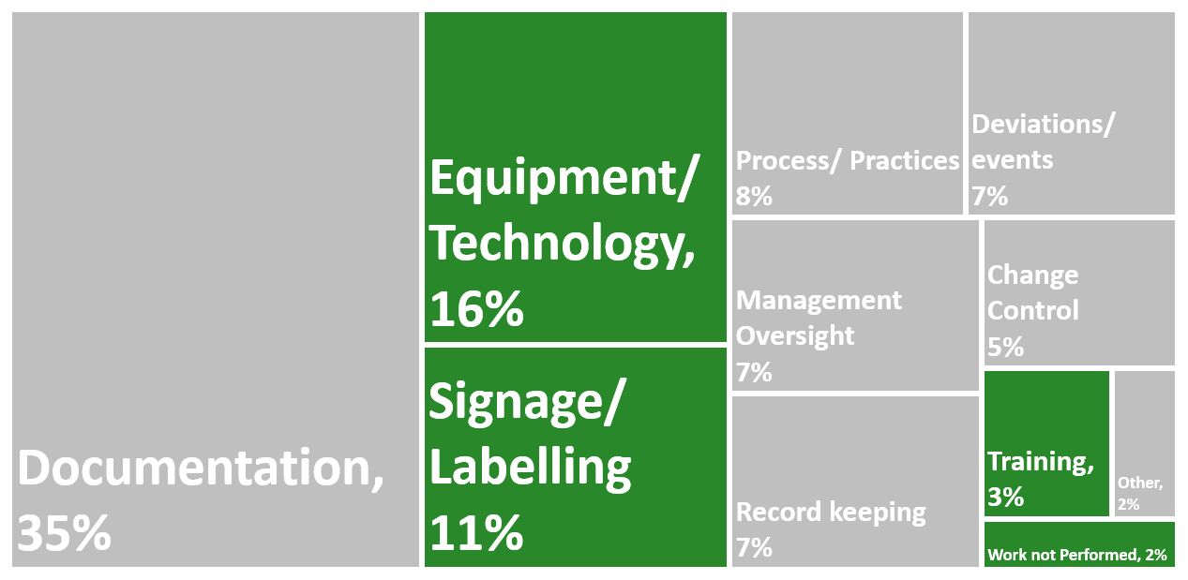
Areas for Improvement - FY2018-19
Notes:
Labelling on some laser devices was deficient.
Dedicated cleaning equipment was not in use in unsealed source laboratories.
Use of appropriately calibrated radiation detection equipment.
Personal dosimetry control badges were not being stored in accordance with accepted best practice.

Slide 20
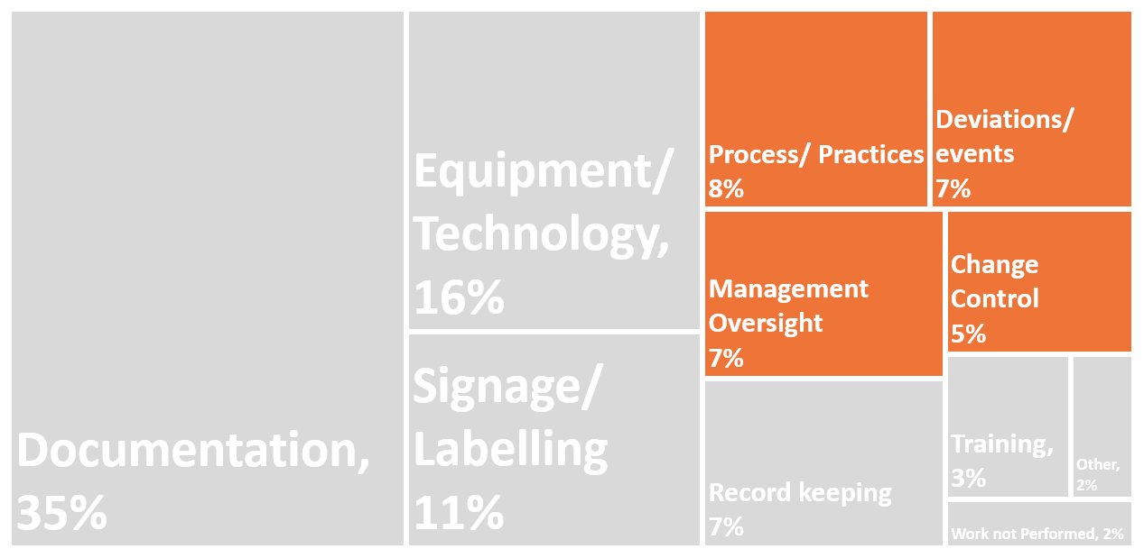
Areas for Improvement - FY2018-19
Notes:
Management oversight of the maintenance task schedule associated with OLCs
The conduct of security categorisation calculations (including aggregates) on the inventories should be performed for all laboratories holding sealed and unsealed radiological materials.
Change management arrangements not adequately addressed.
Establish a program of internal assurance audits/inspections to be performed by suitably trained personnel who have operational independence from the running of the facility using a checklist or criteria developed prior to the first audit/inspection

Slide 21
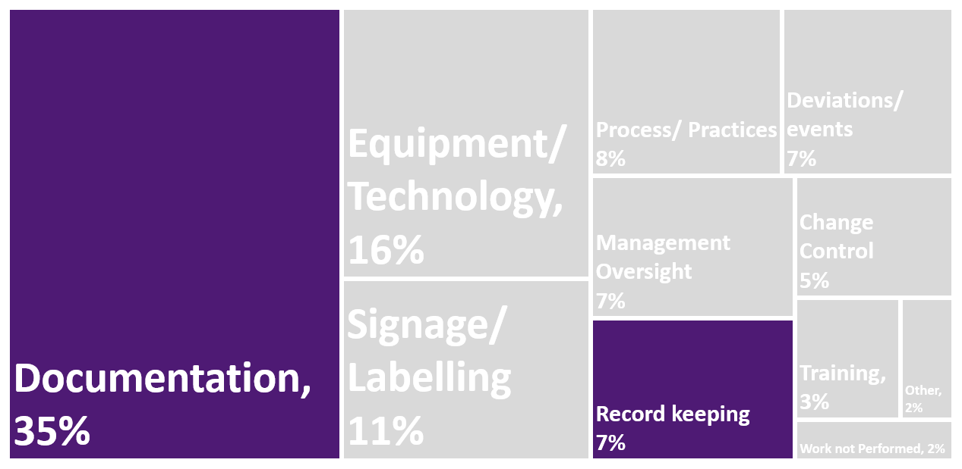
Areas for Improvement - FY2018-19
Notes:
Zoom in on documentation

Slide 22
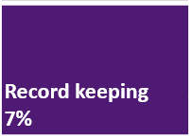
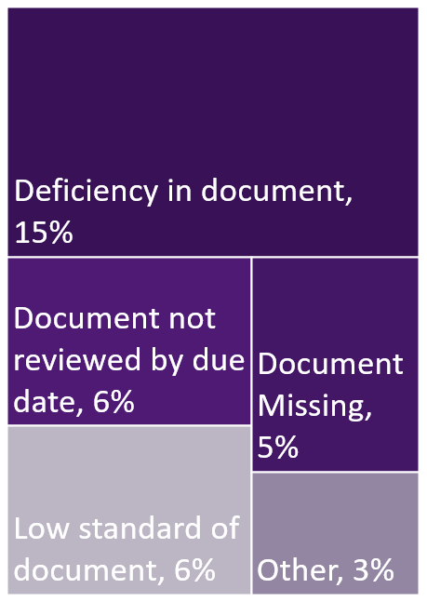
Documentation
Why is it important?
Risk assessments, records, policy and procedures, are key to ensuring risks and controls are effective –
They are artefacts we can assess.
Notes:
Inventory management systems and all plans and arrangements should be updated to reflect newly published ARPANSA Regulations (2018)
Emergency procedures should be reviewed against the ARPANSA Emergency Exposure Guide and exercises should be conducted more frequently against potential incidents in order to verify the adequacy of arrangements.
The facility Plans and Arrangements need to be reviewed against ARPANSA’s regulatory guidance
X radiation management plan should integrate more seamlessly with X existing risk management framework

Slide 23
Safety is a clearly recognized value
Safety Culture Attributes
Leadership for safety is clear
Accountability for safety is clear
Safety is integrated into all activities
Safety is learning driven
Management System
Technology
Safety-System
Strategy
Culture For Safety (IAEA)
Safety is Integrated across divisional boundaries
Notes:
AFIs help organisations to address underlying issues.
Safety culture vs culture for safety
Holistic safety guidelines

Slide 24
Examples
Key safety case documentation, such as the Safety Assessment Report, require revision to ensure they capture current conditions.
Implementation of the annual maintenance strategy.
Incorrect labelling on some UV apparatus.
Review staffing and workloads related to safety functions to ensure these are performed.
Plans should be reviewed against the Regulatory Guide (REG-LA-SUP-2400B) to ensure accountabilities and responsibilities for the licence is consistently documented.
Notes:
Typically an artefact is highlighted, that could be an indicator of an underlying issue - Examples:
Updating the safety case -> safety is learnings driven
Maintenance, is safety integrated?
Workloads may say something about accountability an leadership for safety.

Slide 25
Safety is a clearly recognized value
Safety Culture Attributes (IAEA)
Leadership for safety is clear
Accountability for safety is clear
Safety is integrated into all activities
Safety is learning driven
Management System
Technology
Safety-System
Strategy
Culture For Safety (IAEA)

Slide 26
Feedback
post inspection survey results

Slide 27
What is your overall satisfaction of the Inspection?
88%

Slide 28
Comments
The inspector was very good in communicating the objectives and expectation.
The communication was good, no specific improvement required.
I would like to highlight that the significant work undertaken by the inspection team in the time leading up to the inspection by thoroughly reviewing documentation and information sent prior, significantly improves of the inspection. It feels like the time is used to the effectiveness and efficiency focus on more important areas or seek clarification rather than wasting time on details that are insignificant to safety.
It was all very professional and constructive.
Lead inspector communication is very good. Formally goes through things at entry/exit meeting to ensure that all aspects of the inspection are clear to the operator.
Notes:
We welcome your feedback!
-mostly it is positive

Slide 29
You Said…. We Did…
On sites where risks are minimal a shorter inspection targeting just a few items may be a better use of the inspectors time.
On such short visits the entrance and exit meetings may not be necessary if all party's are familiar with the process and there have not been any significant changes.
For the lowest hazard sources we have been implementing alternative regulatory oversight techniques:
Reduced inspection frequency
New self assessment iAuditor tool (under development)
Use of site visits (non-inspection) and other tools

Slide 30
You Said…. We Did…
In the inspection report, it wasn't clearly stated in the listed corrections that needed to be made, which [organisational] area the corrections were for. This should be clarified as [two organisational areas] were involved in the inspection.
Each year in February we hold a ‘training day’ which includes inspection report writing. During the next training we will look at the clarity of the areas for improvement.

Slide 31
Share Operating Experience
Factors affecting regulatory response
How AFIs can help you to improve, (holistic safety / Safety culture)
Welcome feedback
Share Operating Experience
Factors affecting regulatory response
How AFIs can help you to improve, (holistic safety / Safety culture)
Welcome feedback
Share Operating Experience
Factors affecting regulatory response
How AFIs can help you to improve, (holistic safety / Safety culture)
Welcome feedback
Share Operating Experience
Factors affecting regulatory response
How AFIs can help you to improve, (holistic safety / Safety culture)
Welcome feedback
Recap

Slide 32

Thank You
CONTACT ARPANSA
Email: info@arpansa.gov.au, christopher.nickel@arpansa.gov.au
Website: www.arpansa.gov.au
Telephone: +61 3 9433 2211
Freecall 1800 022 333

Slide 33
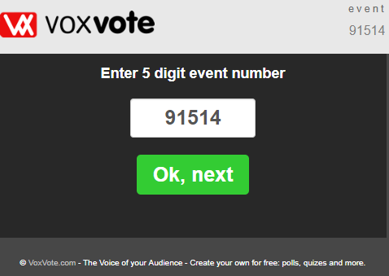
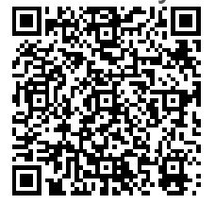
Questions for Audience
What do you think is your greatest area for improvement?
What do you think your greatest area of strength is, that you could share with others?
Live.voxvote.com 91514

