Slide 1
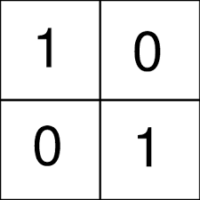
Understanding regulatee behaviour
Deb Cleland
Postdoctoral Fellow
School of Research and Global Governance, ANU
Notes:
Greeting / Intro. Alt+F5 or Alt+S, B
Some other ideas esp re why people would be where they are and how to respond to them…. Psychologist, ATO, WHS, joined her team - now we are looking at Env reg + RJ [test out a few idea on you around that]

Slide 2
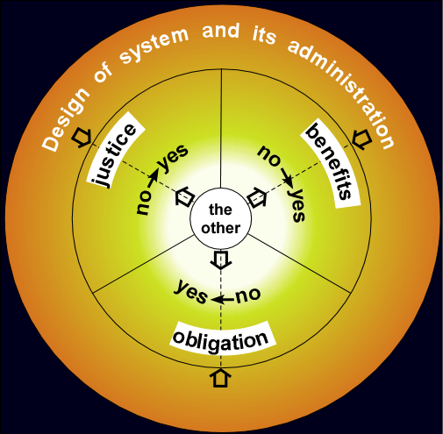
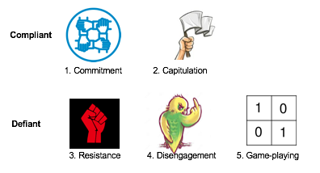
Outline
Two ways to think about what motivates regulatees
‘Wheel of Social Alignments’
‘Motivational postures’
Pathways to more engaged regulation?
Notes:
Hoping you will be able to recognise some of the attitudes and behavours of duty holders - might help to think about why relevant
Examples from tax, higher education, OHS & environmental regulation
OHS / Env reg: labs and workplaces; regulation of human activity impact on the greater environ -> risk/ignorance/trivialisation/fear / regulator for & of?
Uni / Tax - because they are regulatory systems most people in the room will have interacted with.
Pathways - because problems w/out solutions?

Slide 3
Wheel of
Social
Alignments
Braithwaite, Valerie (2009) ‘Tax evasion’ In M. Tonry, Handbook on Crime and Public Policy Oxford: Oxford University Press
Notes:
outer band : design of the regulatory system - sets out laws, rules, enforcement codes and administrative practices.
middle band : how regulatees make choices about compliance (connection justice/morals) – elicit.
inner core of the wheel represents ‘the other’ who is sought out by the regulated (alt authorities) to self-affirm [tax agents, industry bodies)

Slide 4
Example: HECS
Justice
I see [HECS] as promoting access to education...”
No Justice
“it is very unfair that the HECS threshold is lower than average weekly earnings.”
Benefits
“Ensure that HECS remains as it was the only way I could afford to attend university.”
No benefits
“very second rate compared to the amount it costs to get a degree”
Obligation
“I feel you should pay for something that you derive benefit from. In other words, user pays.”
No obligation
“If I was in a high demand skilled category & can work OS without paying HECS I would. “
Braithwaite, Valerie (2009) ‘Tax evasion’ In M. Tonry, Handbook on Crime and Public Policy Oxford: Oxford University Press
Notes:
In general, those with a HECS debt were less likely than those without to see benefits from their educational opportunity, to believe that HECS was implemented fairly, and to feel morally obliged to comply with government authority.
regulatory hot spot (ongoing, suppressed, victorious challenges)

Slide 5
ARPANSA examples?
Justice
No Justice
Benefits
No benefits
Obligation
No obligation
Notes:
egs?
Necklaces (individual v collective safety)
cheap/safe/dangerous/carelessness/unfair targeting/other jurisdictions (eg US), should follow the law, means we are safe and accepted, reputational/social license
other jurisdictions (eg US), ethicists...

Slide 6
Motivational Postures
Are sets of beliefs and attitudes that sum up how individuals feel about and wish to position themselves in relation to authority.
Motivational postures send social signals or messages to the authority about how that authority is regarded.
Braithwaite, Valerie. 2009. Defiance in Taxation and Governance. Cheltenham, UK: Edward Elgar. .
Notes:
Authority threatens everyone, by virtue of being an authority.
As an authority’s threat increases, people use their motivational postures to adjust their social distance and establish a comfort zone for themselves in relation to the authority. Different contexts bring to the fore different postures, and different postures direct individuals to make different responses, some obliging and deferential, others adversarial and dismissive.

Slide 7
Motivational postures
Compliant
1. Commitment
2. Capitulation
Defiant
3. Resistance
4. Disengagement
5. Game-playing
Braithwaite, Valerie. 2009. Defiance in Taxation and Governance. Cheltenham, UK: Edward Elgar. .
Notes:
Commit: values, processes, authority
Capit: just tell me what to do & I'll do it
Resist: unfair, disrespect, changes (maintain authority)
Disengage: at bay, keep distant and distracted
Game: challenge autho, delegit, score points
meow, examples of people you deal with?

Slide 8
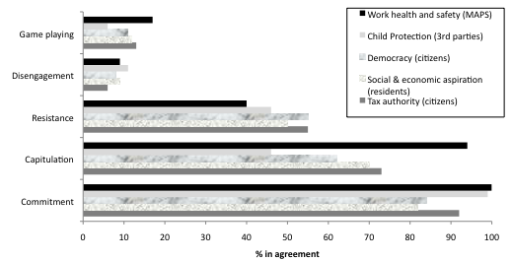
Motivational Postures
The extent to which individuals in five different regulated populations endorsed the five motivational postures in relation to their regulator
Braithwaite V and Cleland D (2017) Compliance and Defiance in Work Health and Safety Regulations. Report to WorkCover Qld
Notes:
illustrate - more than one held
Commitment high
Capit high
Resistance is important - needs continuous engagement
WHS high - important as it's v. similar.

Slide 9
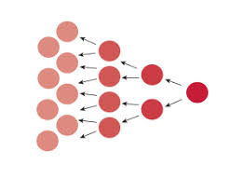
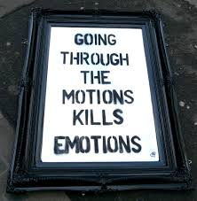
The 3Rs of ratcheting regulatory resistance (sorry)
Rule-proliferation
Ritualism
Risk-shifting
Notes:
rule: tax law - endless loop of loop hole closing and 'tightening' leg - often in context of game-playing, but makes it too hard/rigid for others
ritual: tick-boxing (refer lab in article) reduces commitment
risk: who is responsible? [OHS/travel forms] arse-covering.

Slide 10
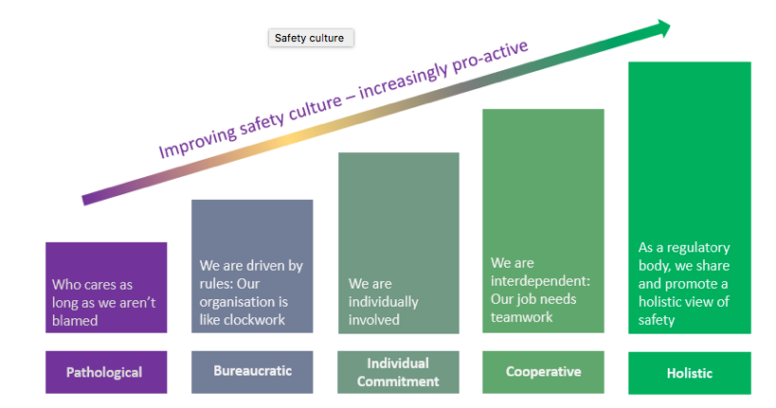
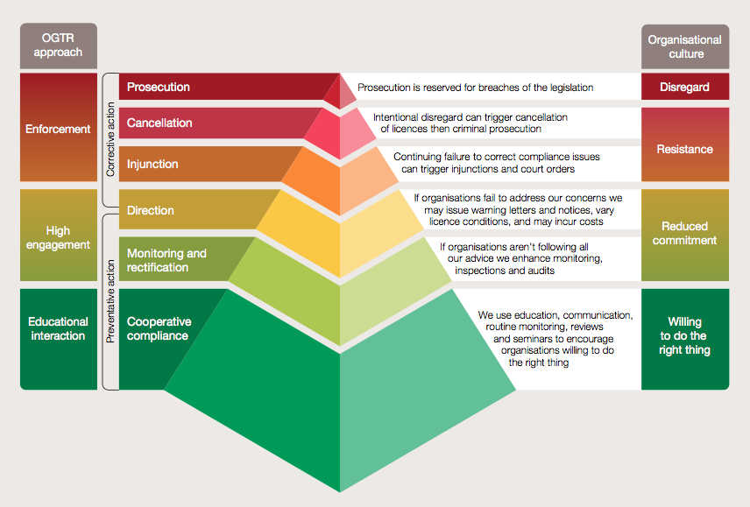
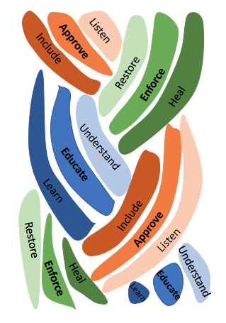
Solutions?
Holistic regulators?
Responsive regulators?
Restorative regulators?

Slide 11
How to make the move to holistic?
Notes:
PRAISE AND REWARDS ASPECT
Mining hazards

Slide 12
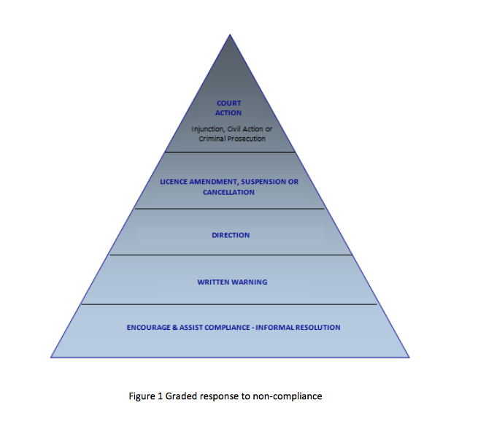
Matching regulatory responses to culture

Slide 13
Matching regulatory responses to culture
Incapacitation
Incompetent or Irrational Actor
Deterrence
Rational Actor
Restorative Justice
Virtuous Citizen
Capacity development
Learning Citizen
Notes:
you use RR (purple is off your chart – reverse pyramid?) same colour scheme (explain responses)
RJ only works where people are prepared to admit they have done well?
How would RJ principles?
- facing victims - victim voice - harm - healing
[going to the site; talking etc] -> inspectors (is it as tangible? who are the victims?)

Slide 14
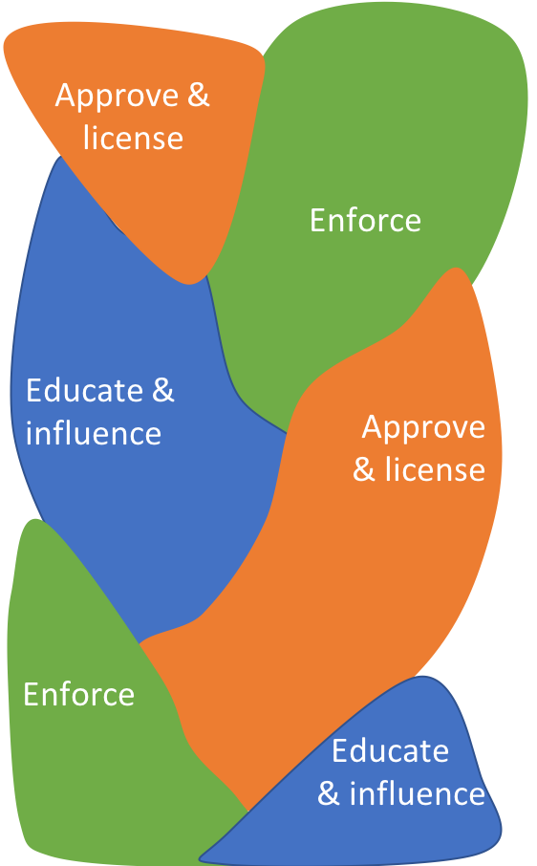
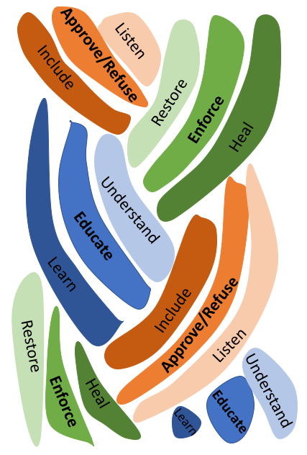
Notes:
New work:
3 overlapping zones of regulatory activity: interrelated - where prosecution is used as reinforcing education messages, engagement might inform licensing etc.
APPROVE – it’s not a coincidence that only the yes word is there; whole system set up: remember this is often approving future harm
Refuse
potential victims? Dialogue.
Listen → only possible if no is an acceptable answer
Change/growth by the regulator/offender
As a model of behavior and norms

Slide 15
Thank you.

